Slide 1


Chukwuemeka Okoli
2nd December 2021

Slide 2

Outline
Executive Summary
Introduction
Methodology
Results
Conclusion
Appendix

Slide 3
Executive Summary
Summary of methodologies
Data Collection through API
Data Collection with Web Scraping
Data Wrangling
Exploratory Data Analysis with SQL
Exploratory Data Analysis with Data Visualization
Interactive Visual Analytics with Folium
Machine Learning Prediction
Summary of all results
Exploratory Data Analysis result
Interactive analytics in screenshots
Predictive Analytics result

Slide 4
Introduction
Project background and context
Space X publicizes Falcon 9 rocket dispatches on its site with an expense of 62 million bucks; different suppliers cost vertical of 165 million bucks every, a significant part of the investment funds is on the grounds that Space X can reuse the primary stage. In this manner, in the event that we can decide whether the primary stage will land, we can decide the expense of a send off. This data can be utilized to offer against space X for a rocket send off. This objective of the undertaking is to make an AI pipeline to foresee on the off chance that the primary stage will land effectively.
Problems you want to find answers
What factors determine if the rocket will land successfully?
The success rate of a successful landing is determined based on the interaction among various features.
What operating conditions needs to be in place to ensure a successful landing program.

Slide 5


Slide 6
Methodology
Executive Summary
Data collection methodology:
Data was collected using SpaceX API and web scraping from Wikipedia.
Perform data wrangling
One-hot encoding was applied to categorical features
Perform exploratory data analysis (EDA) using visualization and SQL
Perform interactive visual analytics using Folium and Plotly Dash
Perform predictive analysis using classification models
How to build, tune, evaluate classification models

Slide 7
Data Collection
The information was gathered utilizing different strategies
Get demand was utilized to gather information of the SpaceX Programming interface.
Then, we decoded the reaction content as a Json utilizing .json() capability call and transform it into a pandas information outline utilizing .json standardize().
We then cleaned the information, checked for missing qualities and fill in missing qualities where essential.
What's more, we performed web scratching from Wikipedia for Hawk 9 send off records with BeautifulSoup.
The goal was to extricate the send off records as HTML table, parse the table and convert it to a pandas information outline for future examination.

Slide 8

Data Collection – SpaceX API
We utilized the get solicitation to the SpaceX Programming interface to gather information, clean the mentioned information and did a few essential information fighting and designing.
The link to the notebook is https://github.com/neelvanani3/Neel-DS-Capstone/blob/master/jupyter-labs-webscraping.ipynb

Slide 9

Data Collection - Scraping
We applied web scrapping to webscrap Falcon 9 launch records with BeautifulSoup
We parsed the table and converted it into a pandas dataframe.
The link to the notebook is https://github.com/neelvanani3/Neel-DS-Capstone/blob/master/jupyter-labs-webscraping.ipynb

Slide 10

Data Wrangling
We performed exploratory information examination and decided the preparation marks.
We determined the quantity of dispatches at each site, and the number and event of each circles
We made landing result name from result segment and sent out the outcomes to csv.
The link to the notebook is https://github.com/neelvanani3/Neel-DS-Capstone/blob/master/labs-jupyter-spacex-Data%20wrangling.ipynb

Slide 11
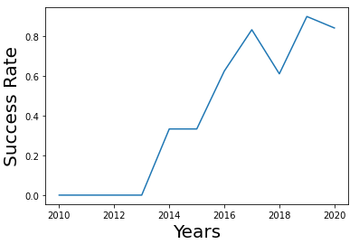
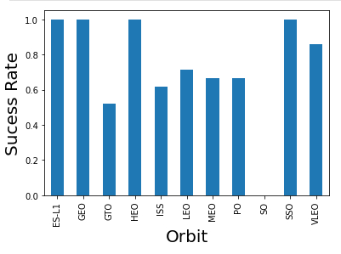
EDA with Data Visualization
We explored the data by visualizing the relationship between flight number and launch Site, payload and launch site, success rate of each orbit type, flight number and orbit type, the launch success yearly trend.
The link to the notebook is https://github.com/neelvanani3/Neel-DS-Capstone/blob/master/jupyter-labs-eda-dataviz.ipynb

Slide 12
EDA with SQL
We load the SpaceX dataset into a PostgreSQL data set without leaving the jupyter journal.
We applied EDA with SQL to get knowledge from the information. We composed questions to find out for example:
Special send off destinations names in the space mission.
The complete payload mass conveyed by supporters sent off by NASA (CRS)
The typical payload mass conveyed by sponsor rendition F9 v1.1
The all out number of effective and disappointment mission results
The bombed landing results in drone transport, their sponsor rendition and send off site names.
The link to the notebook is https://github.com/neelvanani3/Neel-DS-Capstone/blob/master/jupyter-labs-eda-sql-coursera.ipynb

Slide 13
Build an Interactive Map with Folium
We marked all launch sites, and added map objects such as markers, circles, lines to mark the success or failure of launches for each site on the folium map.
We assigned the feature launch outcomes (failure or success) to class 0 and 1 i.e., 0 for failure and 1 for success.
Using the color-labeled marker clusters, we identified which launch sites have relatively high success rate.
We calculated the distances between a launch site to its proximities. We answered some question for instance:
Are launch sites near railways, highways and coastlines?
Do launch sites keep certain distance away from cities?

Slide 14
Build a Dashboard with Plotly Dash
We built an interactive dashboard with Plotly dash
We plotted pie charts showing the total launches by a certain sites
We plotted scatter graph showing the relationship with Outcome and Payload Mass (Kg) for the different booster version.
The link to the notebook is https://github.com/neelvanani3/Neel-DS-Capstone/blob/master/APP.py

Slide 15
Predictive Analysis (Classification)
We stacked the information utilizing numpy and pandas, changed the information, split our information into preparing and testing.
We fabricated different AI models and tune different hyperparameters utilizing GridSearchCV.
We involved exactness as the measurement for our model, further developed the model utilizing highlight designing and calculation tuning.
We found the best performing classification model.
The link to the notebook is https://github.com/neelvanani3/Neel-DS-Capstone/blob/master/SpaceX_Machine_Learning_Prediction_Part_5_(2).ipynb

Slide 16
Results
Exploratory data analysis results.
Interactive analytics demo in screenshots.
Predictive analysis results.

Slide 17


Slide 18
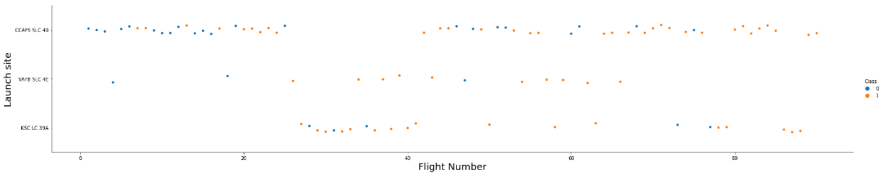
Flight Number vs. Launch Site
From the plot, we found that the larger the flight amount at a launch site, the greater the success rate at a launch site.

Slide 19
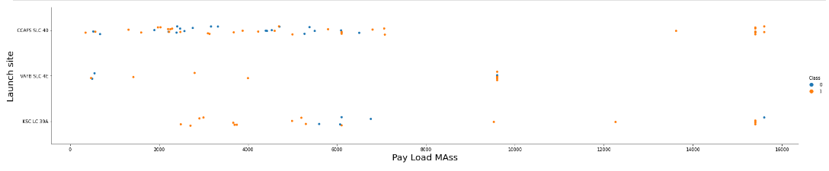
Payload vs. Launch Site

Slide 20
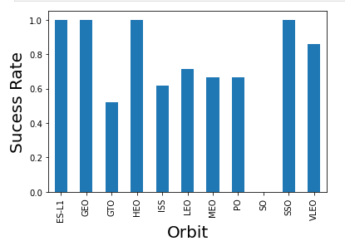
Success Rate vs. Orbit Type
From the plot, we can see that ES-L1, GEO, HEO, SSO, VLEO had the most success rate.

Slide 21
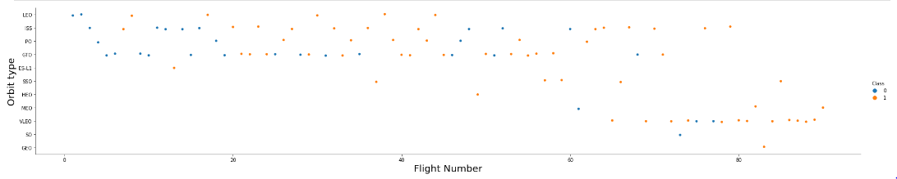
Flight Number vs. Orbit Type
The plot below shows the Flight Number vs. Orbit type. We observe that in the LEO orbit, success is related to the number of flights whereas in the GTO orbit, there is no relationship between flight number and the orbit.

Slide 22
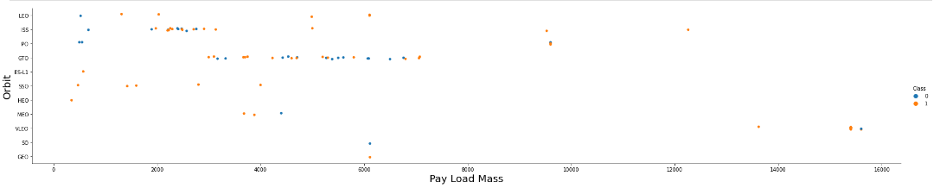
Payload vs. Orbit Type
We can observe that with heavy payloads, the successful landing are more for PO, LEO and ISS orbits.

Slide 23
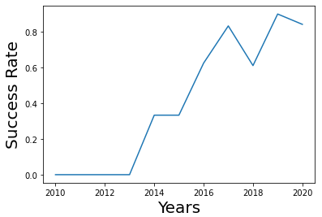
Launch Success Yearly Trend
From the plot, we can observe that success rate since 2013 kept on increasing till 2020.

Slide 24
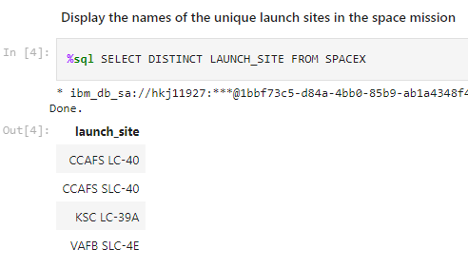
All Launch Site Names
We used the key word DISTINCT to show only unique launch sites from the SpaceX data.

Slide 25
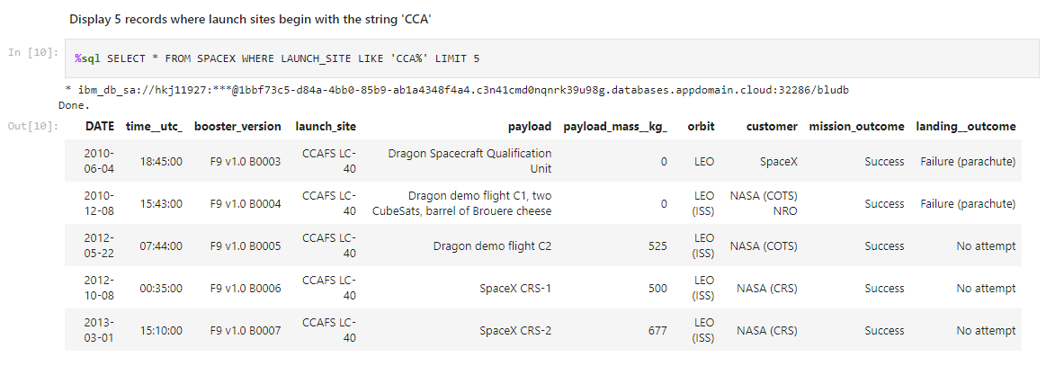
Launch Site Names Begin with 'CCA'
We used the query above to display 5 records where launch sites begin with `CCA`

Slide 26
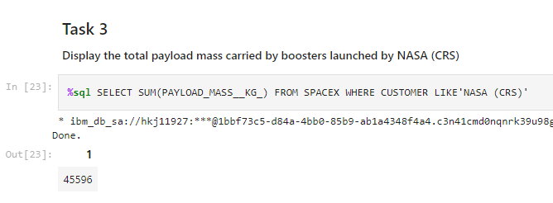
Total Payload Mass
We calculated the total payload carried by boosters from NASA as 45596 using the query below

Slide 27
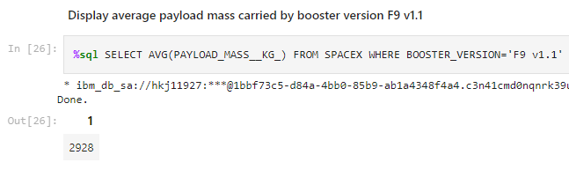
Average Payload Mass by F9 v1.1
We calculated the average payload mass carried by booster version F9 v1.1 as 2928.4

Slide 28
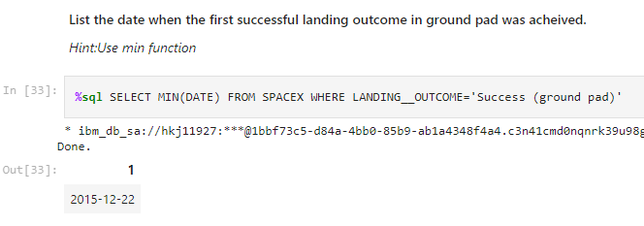
First Successful Ground Landing Date
We observed that the dates of the first successful landing outcome on ground pad was 22nd December 2015

Slide 29
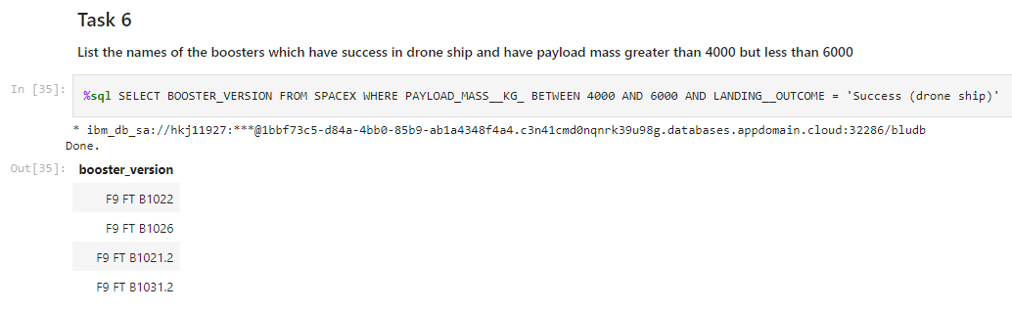
Successful Drone Ship Landing with Payload between 4000 and 6000
We used the WHERE clause to filter for boosters which have successfully landed on drone ship and applied the AND condition to determine successful landing with payload mass greater than 4000 but less than 6000

Slide 30
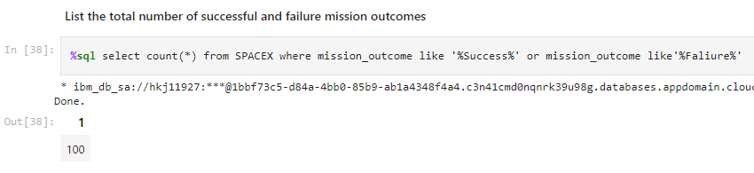
Total Number of Successful and Failure Mission Outcomes
We used wildcard like ‘%’ to filter for WHERE Mission Outcome was a success or a failure.

Slide 31
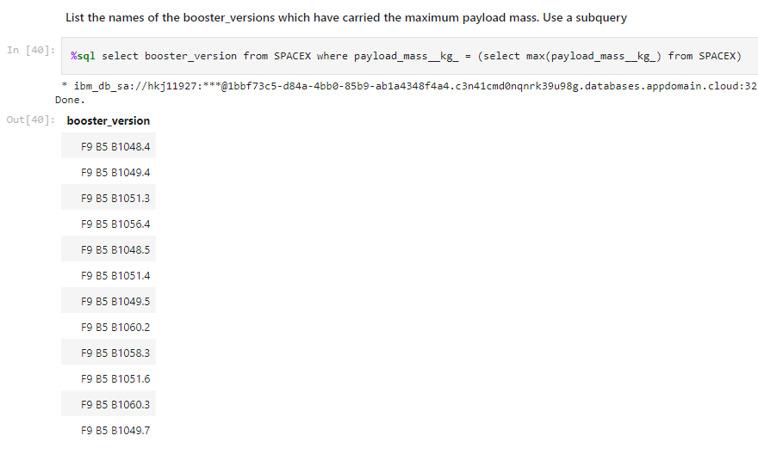
Boosters Carried Maximum Payload
We determined the booster that have carried the maximum payload using a subquery in the WHERE clause and the MAX() function.

Slide 32
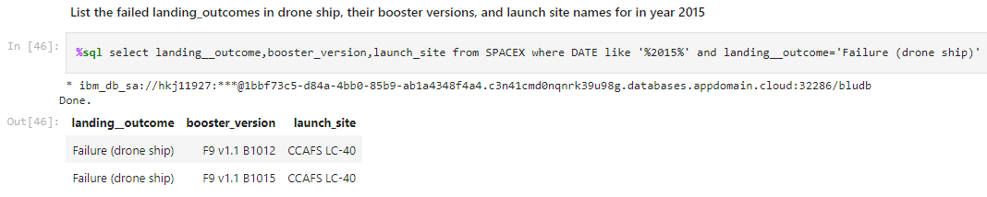
2015 Launch Records
We used a combinations of the WHERE clause, LIKE, AND, and BETWEEN conditions to filter for failed landing outcomes in drone ship, their booster versions, and launch site names for year 2015

Slide 33
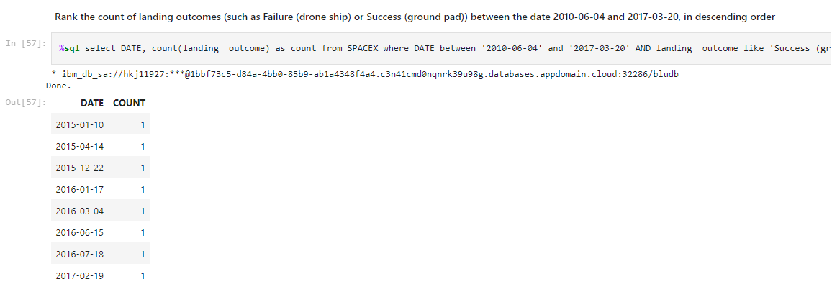
Rank Landing Outcomes Between 2010-06-04 and 2017-03-20
We selected Landing outcomes and the COUNT of landing outcomes from the data and used the WHERE clause to filter for landing outcomes BETWEEN 2010-06-04 to 2010-03-20.
We applied the GROUP BY clause to group the landing outcomes and the ORDER BY clause to order the grouped landing outcome in descending order.

Slide 34


Slide 35
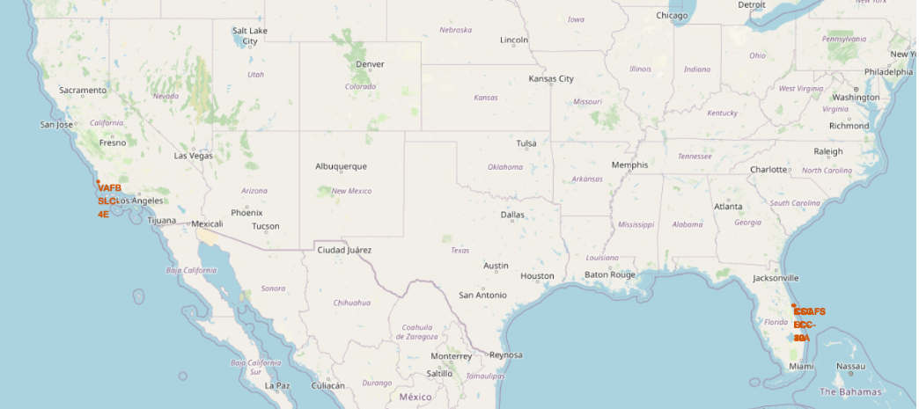
All launch sites global map markers

Slide 36
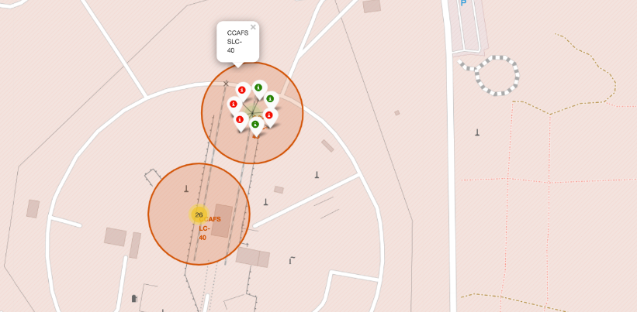
Markers showing launch sites with color labels
From the color-labeled markers in marker clusters, you should be able to easily identify which launch sites have relatively high success rates

Slide 37

Launch Site distance from coast

Slide 38


Slide 39
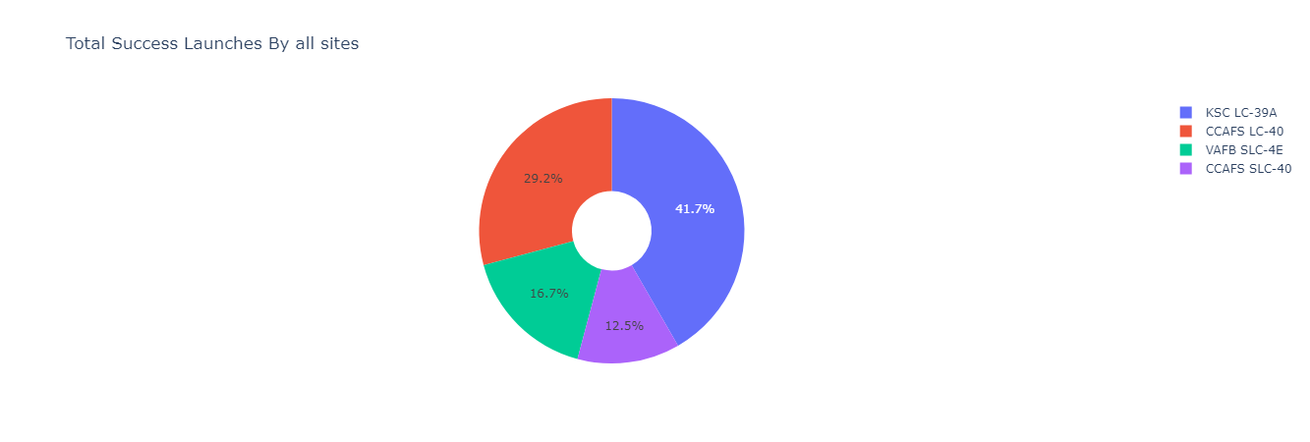
Pie chart showing the success percentage achieved by each launch site

Slide 40
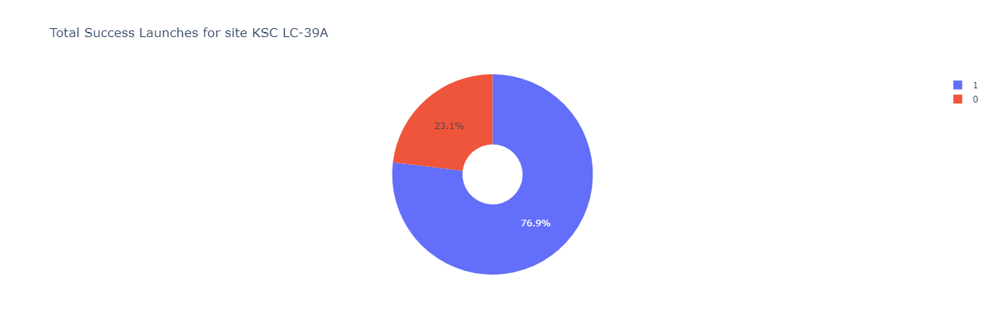
Pie chart showing the Launch site with the highest launch success ratio

Slide 41
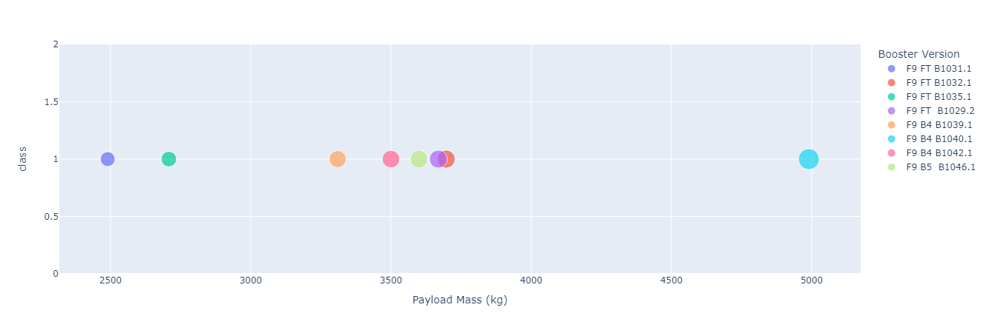
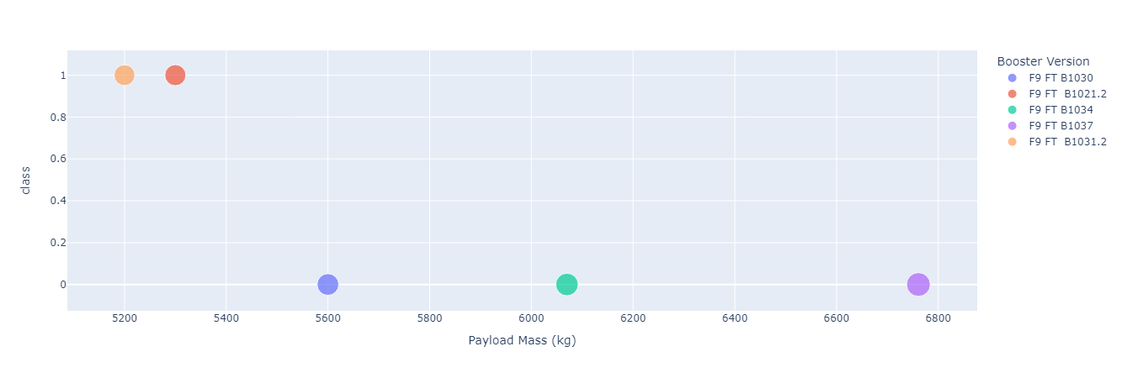
Scatter plot of Payload vs Launch Outcome for all sites, with different payload selected in the range slider
Low payload mass 0-5000 kg
Low payload mass 5000-10000 kg

Slide 42


Slide 43
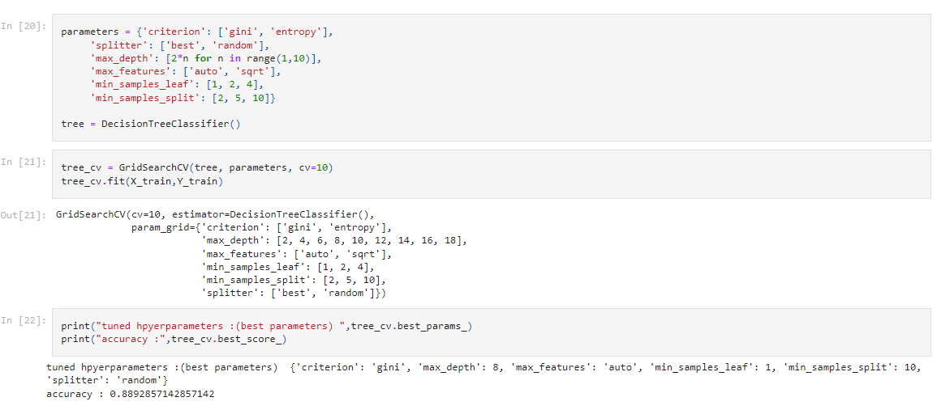
Classification Model Accuracy
The decision tree classifier gives the highest accuracy.

Slide 44
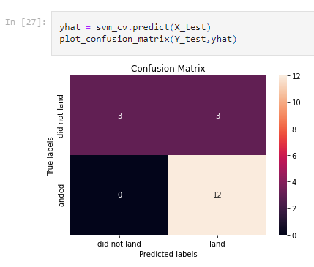
Confusion Matrix
The confusion matrix for the decision tree classifier shows that the classifier can distinguish between the different classes. The major problem is the false positives .i.e., unsuccessful landing marked as successful landing by the classifier.

Slide 45
Conclusions
We can conclude that:
Larger the amount of flight at a launch site, the greater the success rate.
Launch success rate started to increase in 2013 till 2020.
Orbits ES-L1, GEO, HEO, SSO, VLEO had the most success rate.
KSC LC-39A had the most successful launches.
The Decision tree classifier model turns out to be the best machine leaning model for this problem statement.

Slide 46


